Slide 1
Reasons Software Projects Fail (Trying to find the missing pieces)
Michael Dempewolf
Clarke University
March 5, 2015

Slide 2
Agenda
Get to Know One Another
History
Reasons for Failure
Hands on Projects
Share Experiences
Check on Learning
Where to Find More Information
Questions / Discussion

Slide 3
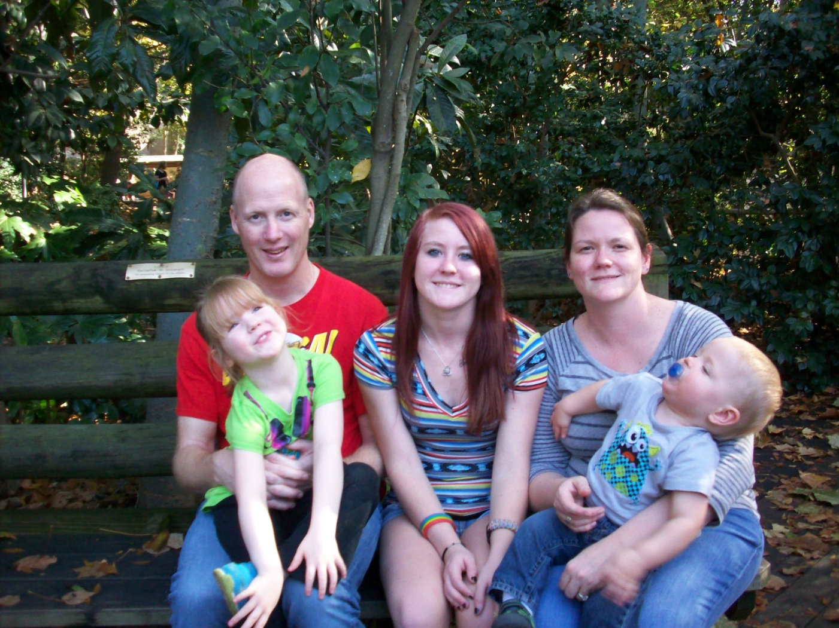
Get to Know One Another
Me
Krisy
Ryan
Claire
Adrienne
Notes:
Who I am.
My Family
Where I live
Where I work
My work history (as it relates to the topic)
My Education and history of teaching
Go Around the Room:
Name, Year in College, What do you want to do when you graduate and/or your areas of interest/passion

Slide 4
Rules of Engagement
Respect everyone
Turn off/Silence Cell Phones
Turn off laptops, tablets (unless taking notes)
Remove any other distractions
Ask questions, share experiences, share insights, challenge assumptions
Learn something, anything!
Notes:
Respect Everyone:
I promise to listen to you and give you my full attention. I ask the same respect from you. And I ask you share that same respect with each other. We are all life learners. We will treat each other as the professionals we are or we want to be.
Turn Off/Silence Cell Phones:
To achieve this, please silence your cell phones. Even better turn them off so the vibration does distract you. If you have to take a call or answer a text, I ask you please leave so as not to distract others who are here to learn.
Ask Questions, share experiences, share insights. Challenge assumptions:
Learn something, anything!
You are investing a good portion of your time – get something out of it
Let me know at the end if you did not learn anything at all. I make it my personal responsibility to make certain I share some new knowledge, some new perspective, or spark a passion or an idea.

Slide 5
Why is this important?
You will be involved with a project
Team Member
Project Manager
Technical Lead
Solo Project
Useful for more than just software projects
Weddings
Class work – Assignments, research papers, thesis
Personal Projects

Slide 6

A Closer Look at the Problem
Notes:
Ask students:
What is success?
What is Failure?

Slide 7
Definition of Project Success
Project Success = meeting stakeholder expectations within the constraints of the project.
Who/What is a stakeholder?
Notes:
Project success equals meeting stakeholder expectations within the constraints of the project.
Who is familiar with the term: stakeholders?
Define the term stakeholders. Cite examples.

Slide 8
Success Rate
Source: Standish Chaos Report 2009
Notes:
Graph showing statistical average of Success, Partial, Failed projects (Standish Group)

Slide 9
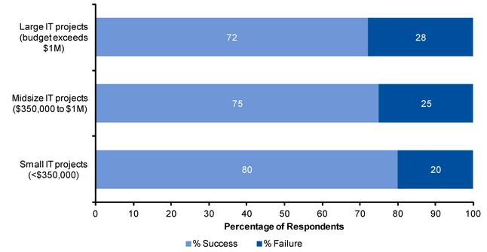
Success Rate – A second view
Source: Gartner June 2012
Notes:
Graph showing 2012 project success (Gartner)

Slide 10
Cost of Project Failure
Standish Group 2004: Cancelled projects cost $55 Billion Annually
Mercer Consulting 2001: Most (80%) projects cost more than they return
British Computer Society 2004: Failed projects cost Tens of Billions of British Pounds

Slide 11
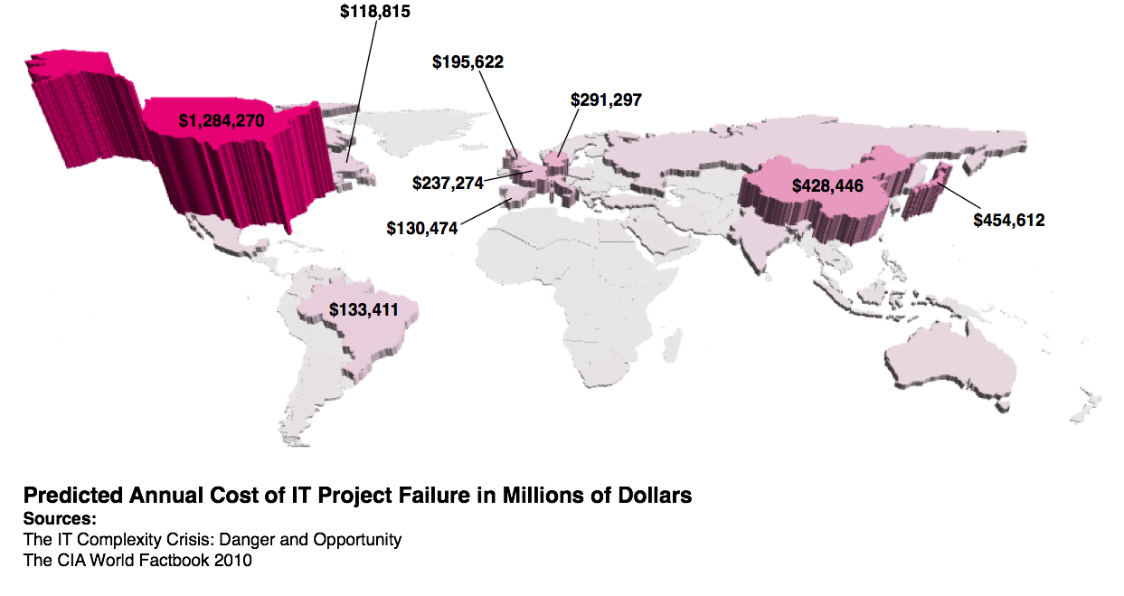
Cost of Project Failure (cont.)

Slide 12
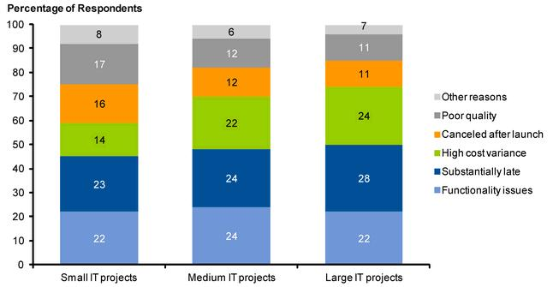
Top Reasons for Failure
Source: Gartner June 2012
Notes:
List of reasons polled from software companies (Gartner)
Focus on Requirements and Scope: costs, time

Slide 13
Top Reasons for Failure
Notes:
Top 10 Reasons for failure (Standish Group)
Focus on Poor Project Management Practices and Requirements

Slide 14
Top Reasons for Failure
Source: Bull Group 1998
Notes:
List of reasons (Bull Group)
Focus on communication, lack of planning, poor quality control
Lots of different data, lots of differing view points, however … some common themese

Slide 15
Our Focus on Why Projects Fail
Requirements
Project Management
Team
Quality Assurance
Culture
Management
Notes:
There are many reasons why software project fail. Based upon the facts, these are the most common reasons listed why software project fails. We will look at each reason in more detail.

Slide 16
Requirements
Focused solely on user requirements
Failure to capture the true requirements
Poor (or no) formal requirement process
Poor (or no) documentation of true requirements
Notes:
Let’s try it and see why …

Slide 17
Class Project – Build a House
I am the contractor
You are the user
I will build your house
What would you like me to build for you
Write it down on the paper provided
Let me know when you are complete
Notes:
(5 Minutes)
Call on students to provide their answers.
Highlight challenges of providing requirements:
Highlight differences and assumptions and talk about the impact to a project when we fail to collect all of the true requirements
Highlight lack of engineering data in specifications: roof snow load, insulation, second floor? Third floor? Walk out basement?
Attached Garage? Porch? Walkout Basement? Siding? Brick? Windows?
Do you want heat? Do you want Air Conditioning? Energy efficient? Geo Thermal? Solar Panels? Wind Power?
Do you want a pool? Indoor? Outdoor? Irrigation?

Slide 18
Story Time – My Past Experiences
A tale of connecting two REST API’s
Material usage
Business logic/rules
FIFO / LIFO strategy

Slide 19
Student Experiences
Have you ever had a project where you were challenged by requirements?
Share your experience:
What was the success status of project?
What were the feelings of the team members on project?
How did you resolve the changes?
What lessons did you learn?

Slide 20
Project Management
No/Poor Project Manager
No/Poor Project Development Process (SDLC)
Poor Communication
No/Poor Change Process
No/Poor Risk Management

Slide 21
Scope (Triangle)
Failure to Understand Scope
Time
Resources/Cost
Requirements

Slide 22

Constraints (Stool)
Quality
Time
Resources
Requirements
Notes:
These are the constraints for the project

Slide 23
Share Personal Story (Project Scope)
The Project Manager who could not say no

Slide 24
Communication
Failure to establish clear modes of communications
Who is working on what?
Roles and boundaries?
How do you handle communication with Virtual Teams?
How do you handle distributed teams?
Major time zone differences?
Cultural differences?
Where do I go to get help/direction?
Failure to communicate with stakeholders (bidirectional)
Failure to establish clear priorities
Notes:
If missed from before …
Who is familiar with the term: stakeholders?
Define the term stakeholders. Cite examples.
How does this relate to success?
Successful project meets the stakeholders expectations.

Slide 25
Change Process
Failure to implement a process for handling change
How do you handle client requests/enhancements?
How do you handle stakeholder requests/enhancements?
How you handle new discoveries?
Failure to handle documentation
Failure to implement control measures
What effect does change have on test plans?
What effect does change have on release date?
What effect does change have on other departments?

Slide 26
Risk Management
Failure to Manage Risks
Failure to constantly review and revise risks and mitigation strategies
Failure to have contingency plans
Failure to communicate risks and mitigation plans to all members

Slide 27
Examples of Risks and Mitigations
Risks?
How do we Mitigate?
Notes:
There are always general risks: requirements, scope, constraints, appropriate resources

Slide 28
Team
Skills
Skills not aligned to project
Lack of expertise
Teamwork
Personality conflicts
Communication
Collaboration
Notes:
Use whiteboard/chaulkboard

Slide 29
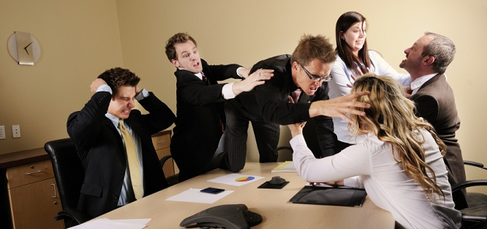
Share Story (Team Challenges)

Slide 30
Quality Assurance
Poor (or no) quality process
Poor (or no) test plans
Extremes: too much time tested or not enough
Cost benefit analysis
Not testing in proper environment
Not catching defects early
Lack of automation

Slide 31
Cost of Defects
Development Phase Defect Found/Fixed | Relative Cost
Requirements | 1
Design | 3-6
Coding | 10
Development Testing | 15-40
Acceptance Testing | 30-70
Operations | 40-1000

Slide 32
Culture
What company cultures have you heard about?
What company would you like to work for?
Why?
Notes:
Ask students about places they have heard of with good cultures.
Where would they like to work?
What is appealing to them? Why?
Would they continue to work there if the culture was toxic?

Slide 33
Culture (cont)
Empowering?
Restrictive?
Toxic?
Collaborative?
Innovative?

Slide 34
Management
Unrealistic expectations
Too many layers - Telephone Game
Change in direction, focus, financial/resource support
Micromanagement
Lack of guidance
Notes:
Who hear has heard of the telephone game?

Slide 35
Management Stories
Daily verbal abusing
A look at Steve Jobs
An innovative, collaborative environment
Constant change in direction
Notes:
3 stories
Daily verbal abusing – a tale of toxic management
Steve jobs – counter example
What is the difference?
Innovative, collaborative – positive example
Constant direction change counter example

Slide 36
Check on Learning
What is the definition for project success?
What are some of the reasons Software Projects Fail?
Provide examples for each reason
Why is it important to find defects early in the process?
Notes:
Project success equals meeting stakeholder expectations within the constraints of the project.
Requirements
Project Management
Team
Quality Assurance
Culture
Management
Cost of Defects at various phases in Development

Slide 37
Where to Find More Information
Search for Statistics for Project Failures
Requirements Process
Business Analysts Book of Knowledge (BABOK)
Project Management
Project Management Book of Knowledge (PMBOK)
Software Development Life Cycle (SDLC)
Technical Leadership Books

Slide 38

Questions?

